Slide 1


Project Presentation of Industry Oriented Hands on Experience (CS-253)
On
AUTOMATION TESTING TOOL
WATERMELON
Vishal Aggarwal
2110991543
Supervised By
Mrs. Pooja Jagtap
Senior Team Lead QualityKiosk Technologies
Department of Computer Science and Engineering,
Chitkara University, Punjab
E-sign

Slide 2
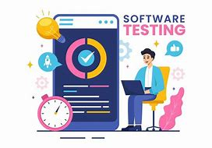
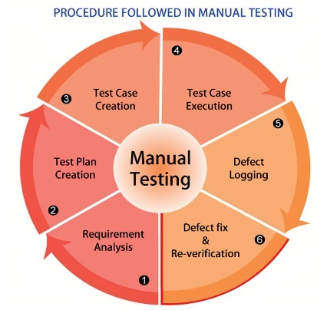
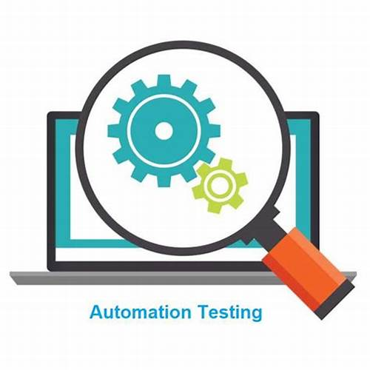
Introduction
AUTOMATION TESTING TOOL – WATERMELON
AI-Driven Enterprise Reliability Platform
What is Software testing?
Process of evaluating software to ensure it meets requirements and functions correctly. Involves identifying defects, ensuring reliability, and improving quality.
Challenges in Manual Testing:
Time-consuming and prone to human errors. Difficult to scale with increasing software complexity. Requires extensive effort for repetitive test cases.
Need for Automation Testing:
Reduces manual effort and increases efficiency. Ensures faster and more reliable test execution. Enables continuous testing in DevOps environments.
2

Slide 3

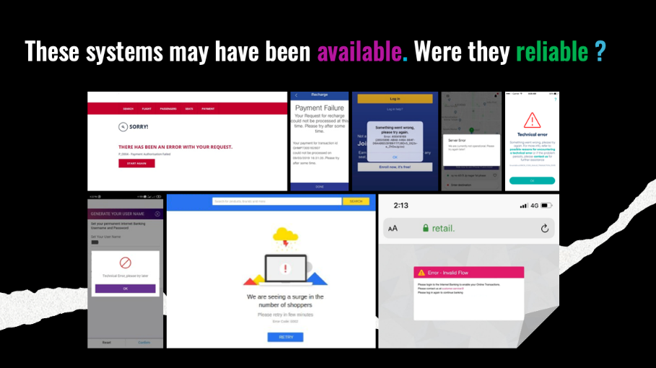

OverView of Watermelon
Watermelon
What is Watermelon?
Watermelon is the World’s only Enterprise Reliability Platform designed to address the crucial challenge faced by enterprises in ensuring the reliability of their software applications. In today's digital age, software reliability is paramount, yet many enterprises struggle to achieve it.
The common understanding of Reliability is “Availability.” As an example, the car illustrated in the above picture is “available.” However, it is definitely not reliable. Technology in general, and software in specific, is no different.
3

Slide 4
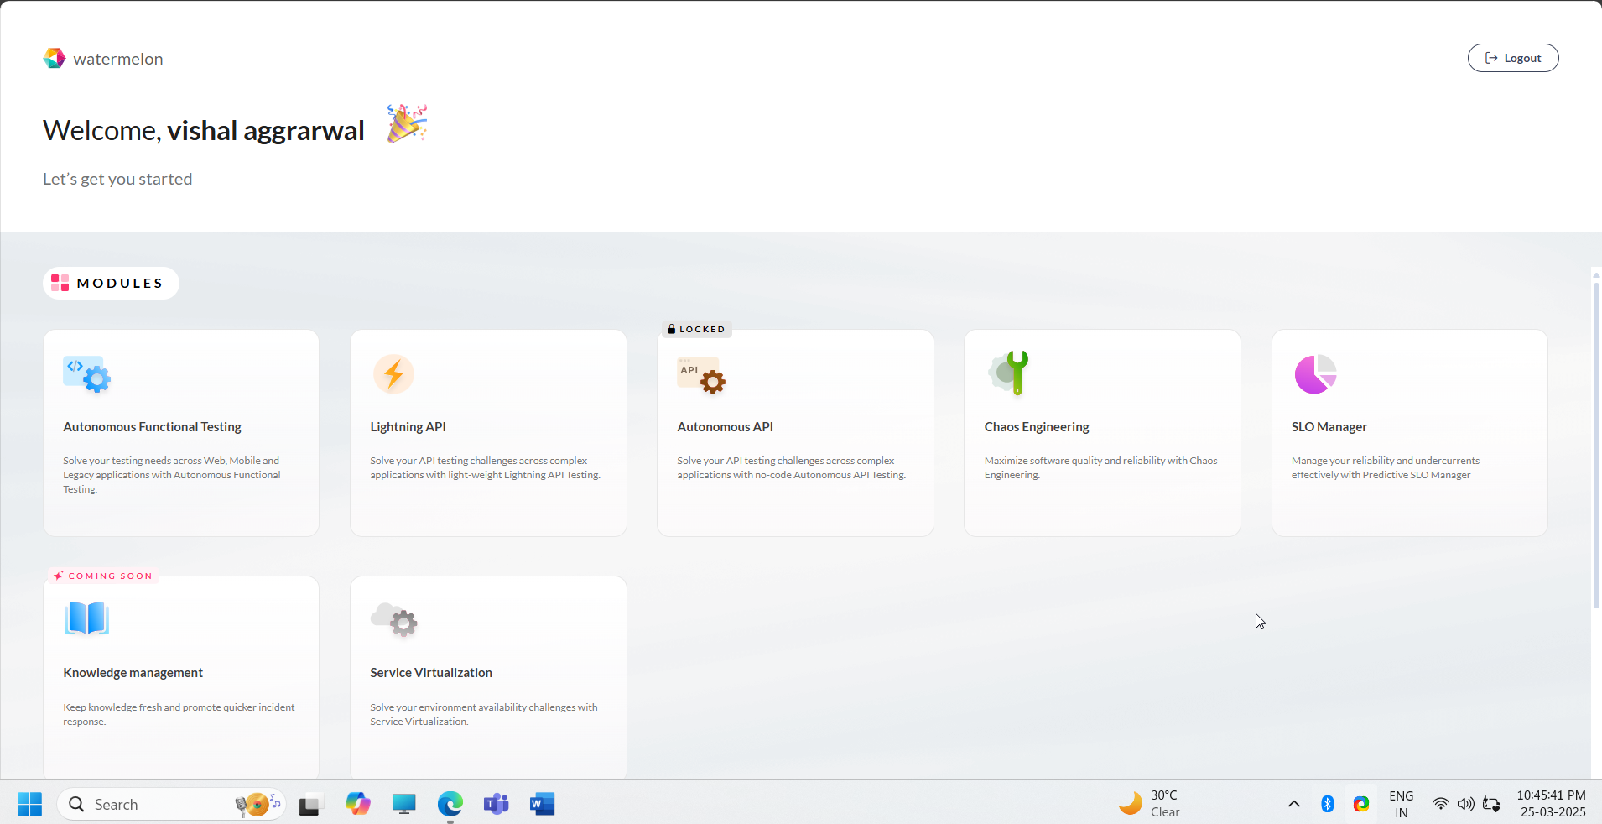
Home Page of Watermelon
We work on

Slide 5
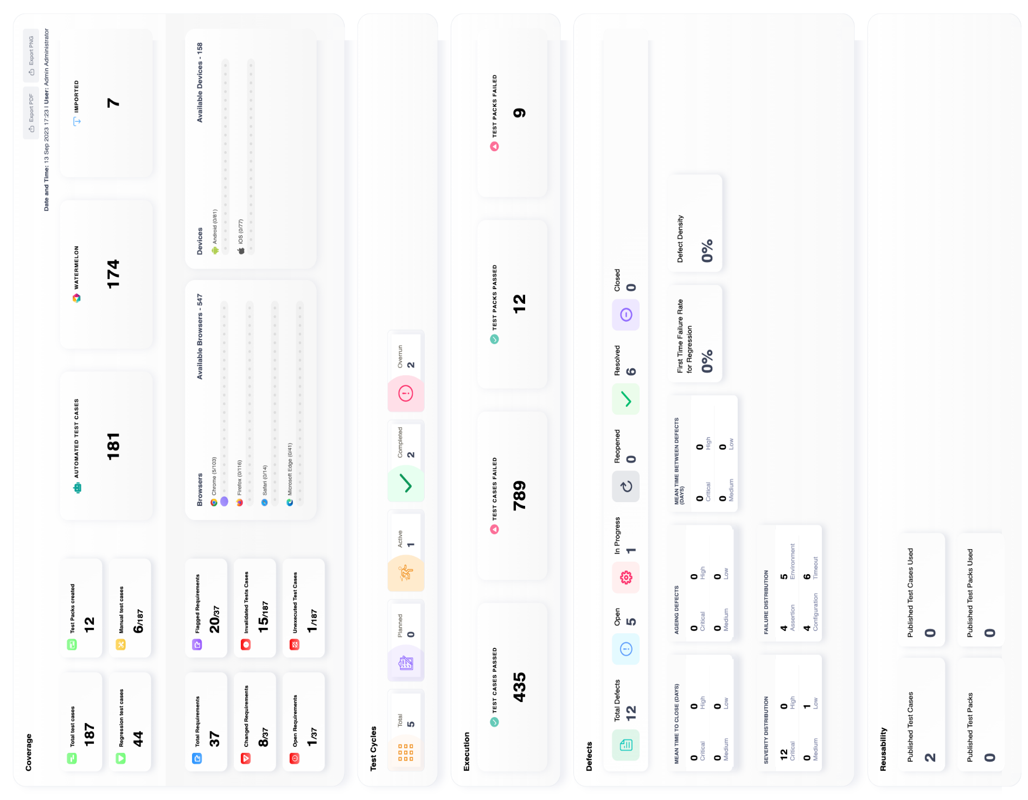

Slide 6
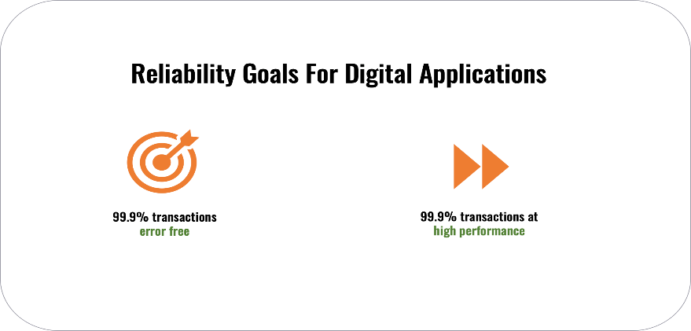
Reliability Challenges in the Real World
However, certain companies like Google, Amazon, and Netflix have demonstrated exceptional reliability in their software. The secret lies in their approach, akin to the automobile industry, where reliability is built into the design process long before reaching production. The bottom line is that reliability is an outcome of a focus on both production and non-production areas at all times. Real reliability is defined as “High Success Rate” and “Highly Performant Transactions.”.
Reliability Challenges in the Real World
Reliability in any enterprise would mean the following:
In practice, large enterprises face the following challenges when it comes to achieving reliability:
• Design: Systems are plagued with unvalidated architecture, operational flaws with unknown failure points, and inherent weaknesses.
• Code: Code is usually developed with a focus on functionality and not always keeping reliability and customer experience in focus. This is hampered due to a lack of deep and early performance/observable insights during development.
• Testing: Testing is complex, siloed, and heavily skills-dependent, making it slow and expensive without achieving the right outcome. It is seen as a cost centre rather than a quality centre

Slide 7

• Release: Customer experience and system stability do not influence release cadence, causing an imbalance between velocity and stability.
• Observability: Observability is not comprehensive and reactive in nature, leading to unmeasured undercurrents impacting customer experience consistently.
• Incident Response: Incident response is reactive due to a lack of proper knowledge management to address incidents swiftly either manually or through auto-remediation.
Key Features:
AI-powered self-healing automation (reduces script maintenance).
No-code automation (manual testers can automate without programming).
Predictive analytics (identifies high-risk areas in software).
Cross-platform and CI/CD integration (ensures seamless testing).
Data-driven testing (uses AI to generate and validate test data).

Slide 8


Why Watermelon?
Why Watermelon?
Enhances software reliability and test coverage.
Reduces time, cost, and effort in software testing.
Enables faster time-to-market with high-quality releases.
How Watermelon Addresses These Challenges?
Watermelon achieves its mission by offering a comprehensive set of modules that cover both pre-production and post-production aspects of the application lifecycle. The end goal of using Watermelon is to help enterprises meet their reliability goals, primarily defined by two key metrics:
1. High Success Rates: Watermelon ensures that a high percentage of transactions are completed successfully without errors. This metric reflects the precision and robustness of applications, reducing the risk of disruptions caused by faulty transactions
2. Performance: Watermelon focuses on achieving a high percentage of transactions completed within an acceptable time frame. This metric measures the responsiveness and efficiency of applications, ensuring that user experiences are consistently smooth and efficient.

Slide 9
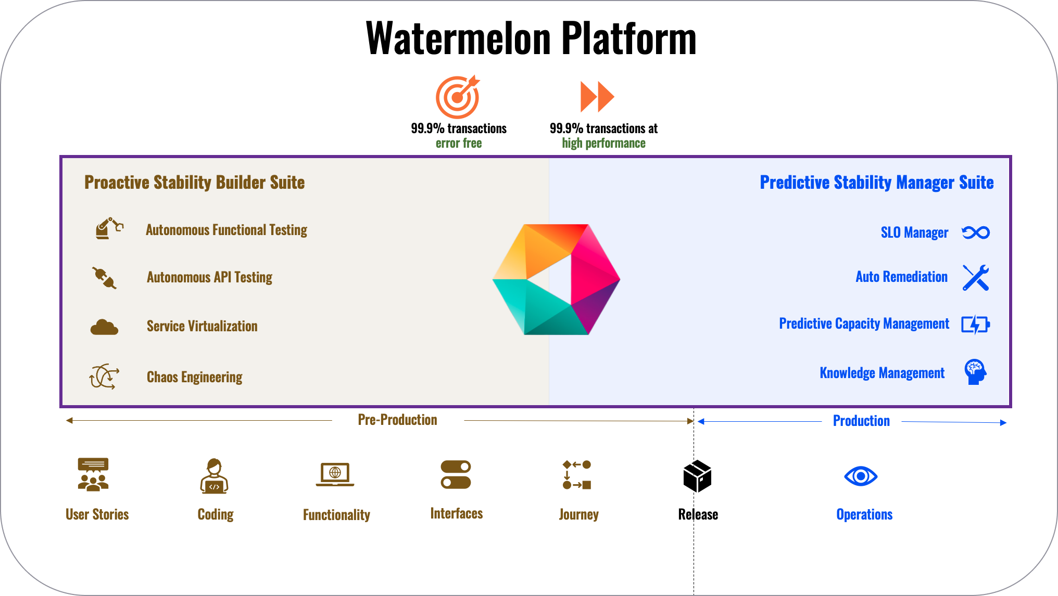

Slide 10

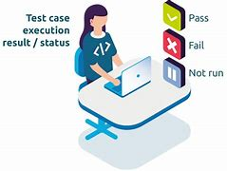

Challenged in Traditional Software Testing
3. High Maintenance Effort:
Frequent UI and code changes break test scripts.
Manual script maintenance is time-consuming and costly.
4. Slow Test Execution:
Running large regression test suites takes hours or days.
Lack of smart test selection increases execution time.
5. Limited Scalability:
Cross-platform and multi-device testing is complex.
Parallel execution setups require significant manual effort.

Slide 11
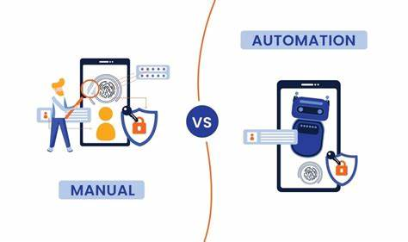
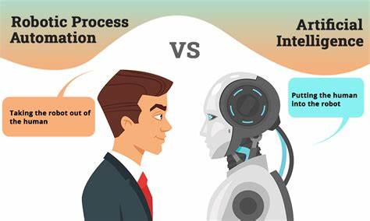
Challenged in Traditional Software Testing
6. Inefficient Defect Detection:
Traditional tools execute pre-defined test cases without adaptive learning.
No AI-driven defect prediction or intelligent failure analysis.

Slide 12
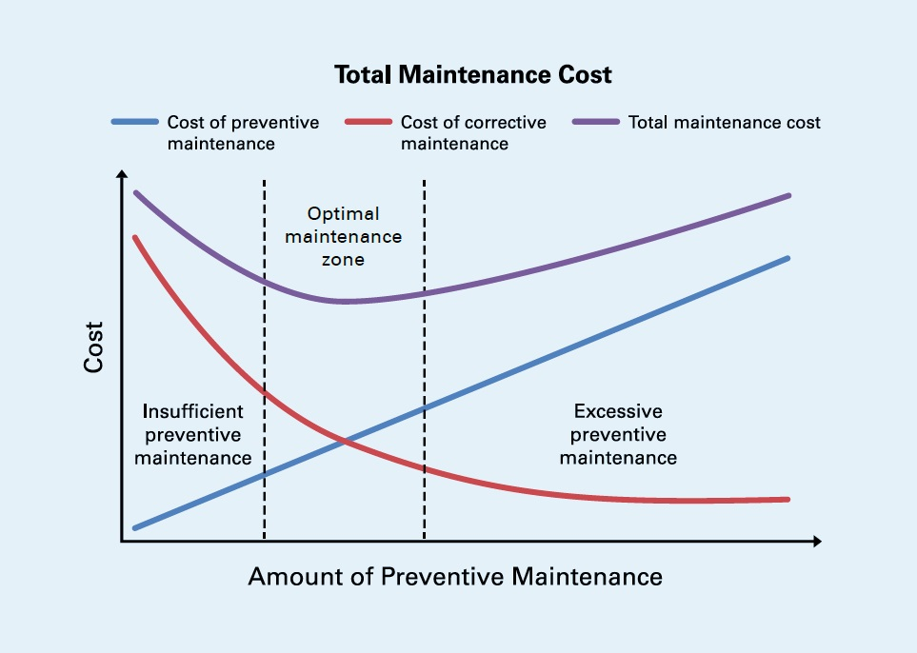
Existing Issues In Software Testing
Watermelon was developed to tackle critical pain points in traditional automation tools:
1. High Maintenance Effort for Test Scripts
Frequent UI updates break automation scripts.
Testers spend excessive time fixing broken scripts.
2. Lack of Intelligent Defect Detection
Traditional automation tools don’t learn from past failures.
No predictive analytics to optimize test execution.
3. Difficulty in Scaling Tests Across Platforms
Cross-browser and mobile testing require separate configurations.
High execution time for multi-device testing
4.Fragmented Test Management
Test cases, defects, and requirements are stored across multiple tools (JIRA, Azure DevOps, Excel).
Lack of centralized test tracking causes inefficiencies.
5. Inefficient Regression Testing
Running a large number of test cases even when only a few features are updated.
No AI-based prioritization of high-risk areas

Slide 13
How Watermelon Overcomes Software Testing Challenges
Watermelon is designed to eliminate inefficiencies in traditional automation testing using AI-driven automation, predictive analytics, and seamless DevOps integration.
AI-Powered Test Automation
Self-healing scripts automatically adapt to UI & functional changes.
Reduces maintenance efforts and script failures.
2. No-Code Test Case Creation
Enables manual testers to automate test cases without programming.
Drag-and-drop functionality for easier test design.
3. Smart Test Execution with AI
AI prioritizes high-risk test cases, reducing execution time.
Optimized regression testing prevents unnecessary test runs.

Slide 14
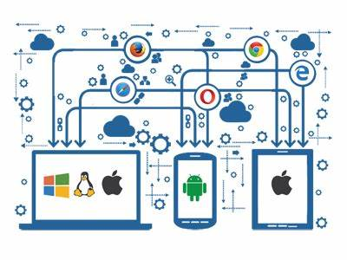
4. Seamless DevOps & CI/CD Integration
Watermelon integrates with JIRA, Jenkins, Azure DevOps, etc.
Enables continuous testing across software development cycles.
5. Scalable & Cross-Platform Testing
Supports testing across web, mobile, and desktop applications.
Parallel execution capabilities for faster results.

Slide 15
Key Features & Functionalities of Watermelon
Watermelon offers a comprehensive suite of automation features to improve test efficiency, reduce costs, and enhance software quality.
Self-Healing Test Automation
AI detects and adapts to UI changes, reducing script failures.
No-Code Test Automation
Enables non-technical testers to create automated test cases.
Predictive Analytics for Smart Testing
AI-driven risk-based test selection for optimized execution.
End-to-End Test Automation
Supports web, mobile, desktop, API testing, and integration testing.
CI/CD Pipeline Integration
Seamlessly integrates with DevOps tools for automated deployments.
Data-Driven Testing
AI generates test data & validates results for comprehensive coverage.

Slide 16
Watermelon Use Case Diagram
The Use Case Diagram illustrates how different users interact with Watermelon and its core functionalities.
Key Components of the Use Case Diagram:
Actors (Users & External Systems):
Test Engineer: Creates, executes, and monitors test cases.
DevOps Engineer: Integrates Watermelon with CI/CD pipelines.
Project Manager: Reviews test results and ensures quality standards.
Watermelon System: The automation testing platform itself.
Use Cases (Functionalities Provided by Watermelon):
Create and Manage Test Cases (No-Code Test Creation).
Execute Automated Tests (Web, Mobile, API Testing).
Integrate with DevOps Tools (JIRA, Azure DevOps, Jenkins).
Generate AI-Driven Reports (Test Results & Insights).
Apply Self-Healing Mechanisms (Fixes UI Changes Automatically).

Slide 17
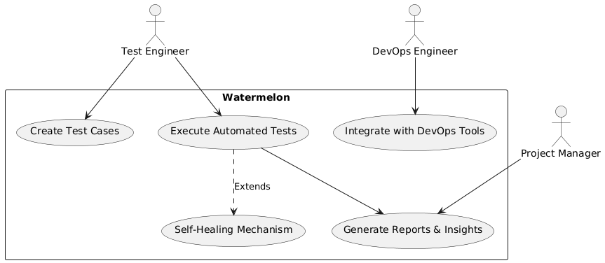
3. Relationships Between Components:
Association: Direct interactions (e.g., Test Engineer → Execute Tests).
Include: Required actions (e.g., Execute Tests → Generate Reports).
Extend: Optional actions (e.g., AI Self-Healing only triggers when needed).

Slide 18

Watermelon Component Diagram
The Component Diagram represents the structural architecture of Watermelon, showcasing how different modules interact.
Key Components of the Watermelon System:
User Interface (UI) Module:
No-code test creation dashboard.
Test case management and execution interface.
Test Execution Engine:
Executes automated test scripts across different platforms.
Supports parallel test execution for efficiency.
AI-driven Optimization Module:
Implements self-healing automation for dynamic UI changes.
Uses AI to prioritize high-risk test cases for execution.
DevOps Integration Module:
Connects Watermelon with JIRA, Jenkins, Azure DevOps.
Enables seamless CI/CD integration for automated deployments.

Slide 19

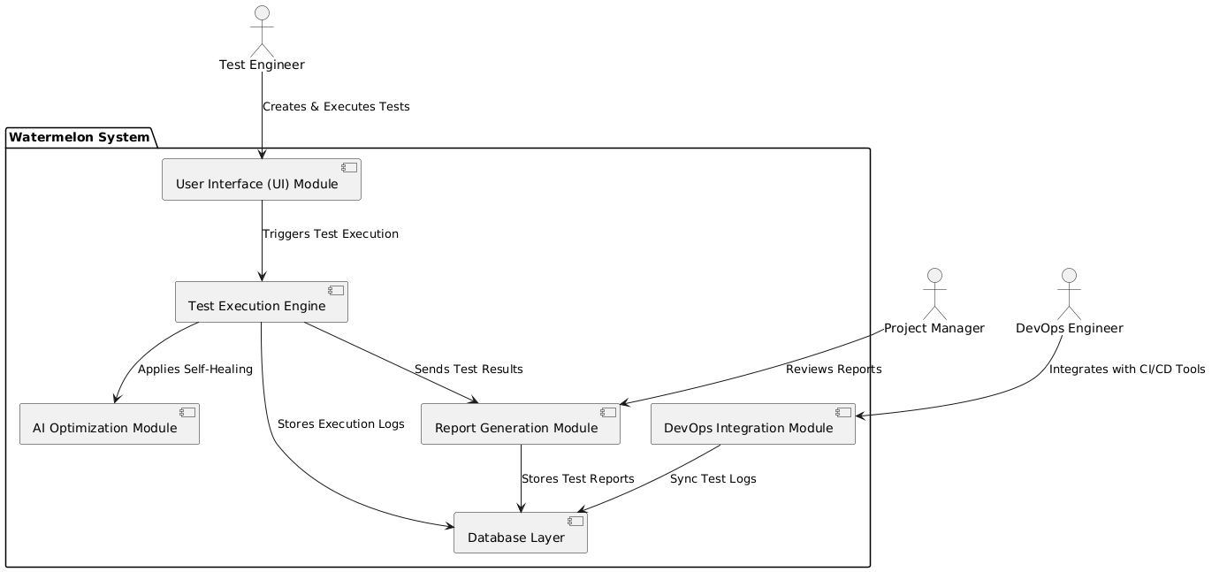
5. Database Layer:
Stores test scripts, execution logs, and historical data.
Supports relational databases like PostgreSQL, MySQL.
6. Report Generation Module:
AI-powered test reports with performance analytics.
Custom dashboards and real-time defect tracking.

Slide 20
Test Execution Flow in Watermelon
A Sequence Diagram represents how different system components interact over time during the test execution process in Watermelon.
Key Components in the Sequence Diagram:
Actors (Users & Systems):
Tester: Initiates the automation test.
Test Execution Engine: Runs the test scripts.
AI Optimization Module: Applies self-healing and predictive analytics.
DevOps Integration Module: Connects with tools like JIRA, Jenkins.
Database Layer: Stores test execution logs and reports.
Report Generation Module: Creates detailed test reports and analytics.

Slide 21
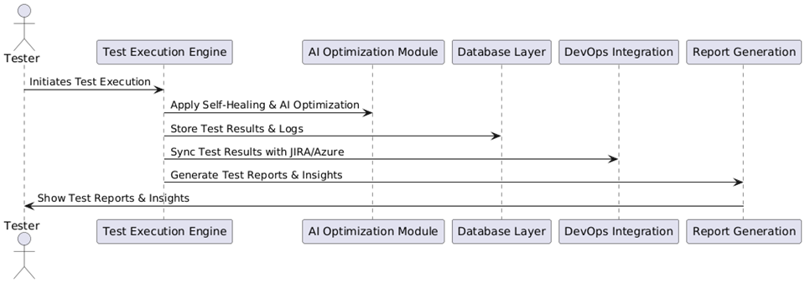
Step-by-Step Execution Flow:
1. User initiates test execution (selects test cases & starts the test).
2. Test Execution Engine runs test scripts on web/mobile/desktop.
3. AI Optimization Module applies self-healing (adjusts test cases for UI changes).
4. Execution logs & results are stored in the Database Layer.
5. DevOps Integration Module syncs test results to JIRA/Azure DevOps.
6. Report Generation Module creates AI-driven reports & sends notifications.

Slide 22
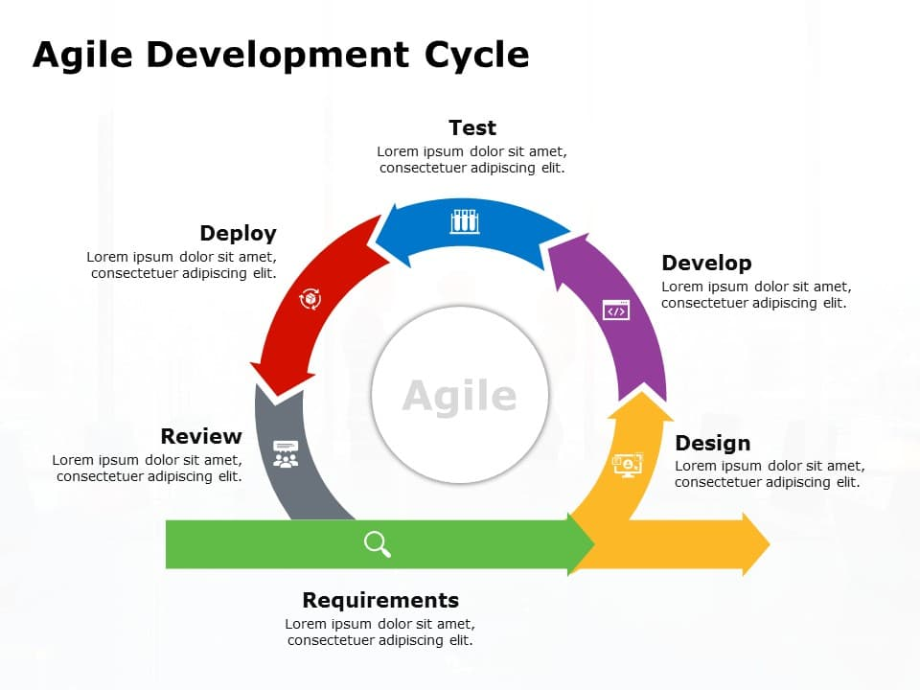
Agile-Based Development of Watermelon
Watermelon follows an Agile development approach to ensure flexibility, faster iterations, and continuous improvements.
1. Agile Methodology in Watermelon
Watermelon is developed in short iterative cycles to accommodate evolving requirements.
Focus on continuous feedback & improvements based on real-world usage.
2. Scrum Framework for Watermelon Development
Sprint Planning: Define tasks & features for each sprint.
Daily Stand-ups: Track progress, discuss blockers, and ensure smooth execution.
Sprint Review: Demonstrate completed features and get feedback.
Retrospective: Analyze what worked well and what needs improvement.

Slide 23
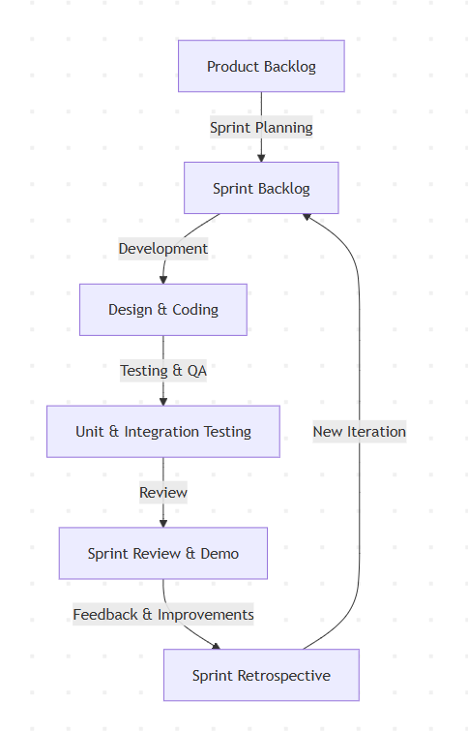
3. Phases of Watermelon Development
Requirement Analysis:
Identify automation needs & integration points.
System Design & Architecture:
Develop modular architecture with AI optimization.
Development & Implementation:
Code development using Python, JavaScript, and Java.
Testing & Validation:
Execute unit, integration, and system tests.
Deployment & Monitoring:
Deploy on cloud/on-premise & continuously monitor performance.

Slide 24
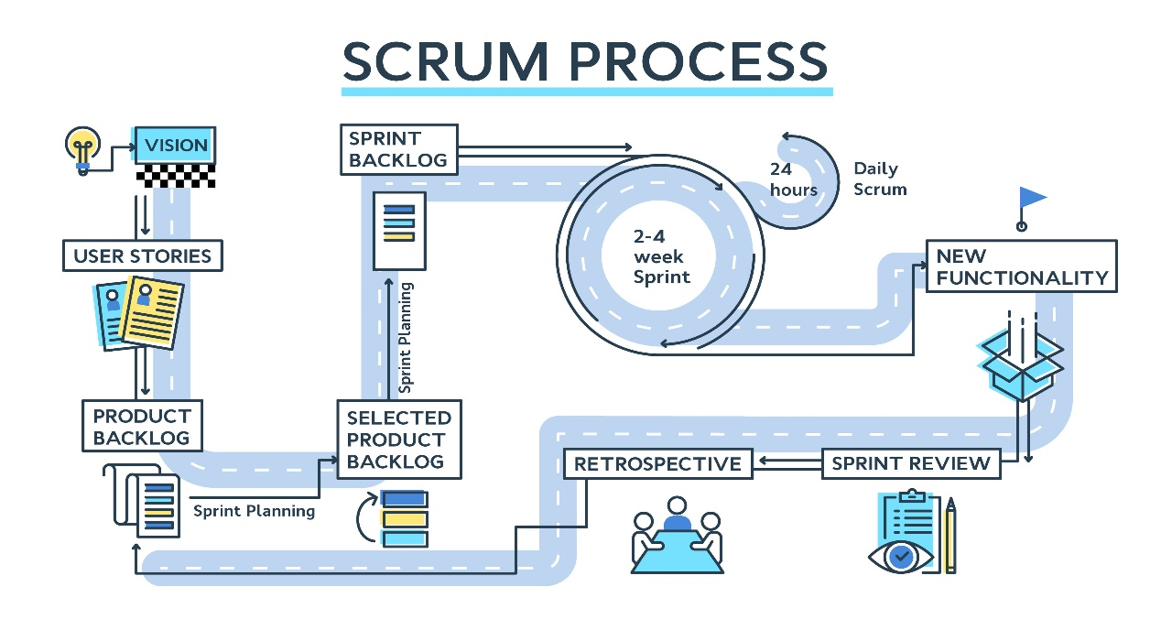
Explanation of the Scrum Workflow:
1. Product Backlog: List of all tasks and features.
2. Sprint Planning: Selects backlog items for the sprint.
3. Sprint Backlog: Work planned for the sprint.
4. Development (Design & Coding): Teams start developing features.
5. Testing & QA: Ensures functionality, performance, and quality.
6. Sprint Review & Demo: Stakeholders review and provide feedback.
7. Sprint Retrospective: Team discusses improvements.
8. New Iteration: The next sprint begins.

Slide 25
Implementation of Automation Testing in Watermelon
Watermelon follows a structured approach to AI-driven test automation, making testing efficient, scalable, and intelligent.
Phase-wise Implementation of Watermelon
Requirement Analysis
Identify key testing objectives & automation needs.
Select deployment type (Cloud, On-Premise, Hybrid).
Setup & Configuration
Install Watermelon and configure integrations with JIRA, Jenkins, Azure DevOps.
Define user roles & permissions for test management.
Test Case Development
Create test cases using No-Code Automation.
Implement Self-Healing Mechanisms for dynamic UI changes.
Execution & Monitoring
Schedule & execute automated tests across platforms.
Monitor results and leverage AI-driven insights.

Slide 26
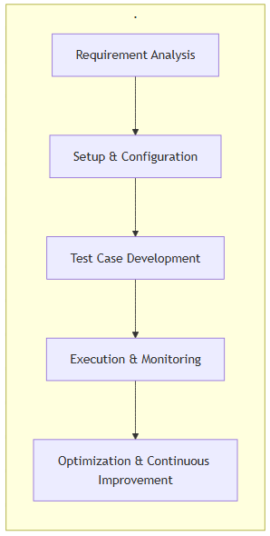
5. Optimization & Continuous Improvement
Refine test strategies based on execution data.
Maintain and update test cases for evolving applications.
2. Key Features Enabling Automation
✅ Self-Healing Automation – AI dynamically adjusts scripts to UI changes.
✅ No-Code Test Creation – Manual testers can create tests without programming.
✅ Predictive Test Execution – AI identifies high-risk test areas for optimized execution.
✅ CI/CD Integration – Continuous testing in Jenkins, Azure DevOps pipelines.
✅ Data-Driven Testing – AI-generated test data ensures test coverage.

Slide 27
Watermelon’s Technology Stack
Watermelon leverages cutting-edge AI, cloud, and DevOps technologies for seamless automation.
1. Programming Languages & Frameworks
✅ Python – Core automation scripts & AI processing. ✅ JavaScript & React.js – Web UI for test case management. ✅ Java & Selenium – Browser automation & functional testing.
2. Databases & Storage
✅ PostgreSQL / MySQL – Storing test cases, execution logs. ✅ MongoDB – NoSQL storage for AI-driven analytics.
3. DevOps & CI/CD Integrations
✅ JIRA, Azure DevOps, Jenkins – Test & defect management. ✅ GitHub Actions, GitLab CI/CD – Automated build pipelines. ✅ Kubernetes & Docker – Containerized deployment of testing environments.
4. AI & Automation Technologies
✅ Machine Learning for Predictive Testing – AI-driven test selection. ✅ Self-Healing Automation – Adapting test scripts dynamically. ✅ Natural Language Processing (NLP) – No-code test case creation.

Slide 28
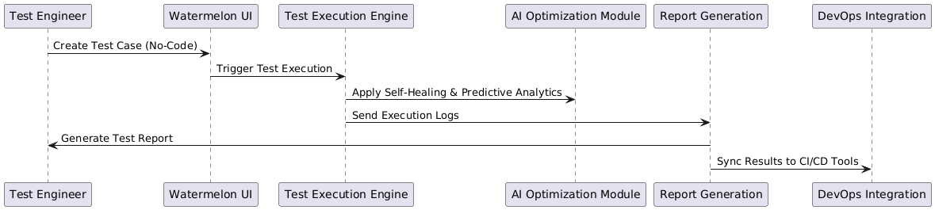
Watermelon in a Testing Pipeline

Slide 29
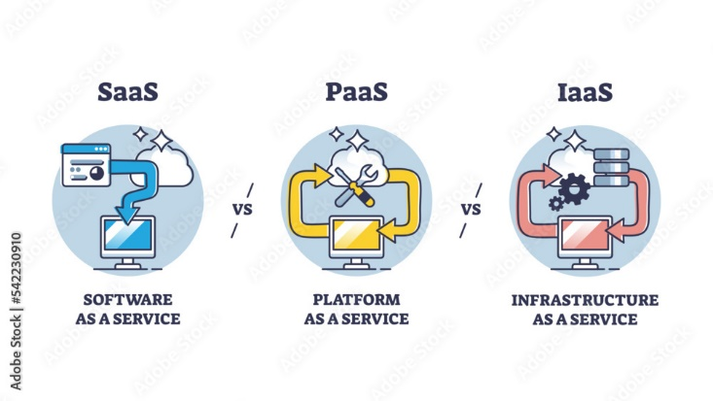
Watermelon Deployment Models
Watermelon offers flexible deployment options to suit different organizational needs, including cloud-based and on-premise solutions.
1. Cloud-Based Deployment
✅ Watermelon SaaS (Software-as-a-Service)
Fully managed by Watermelon, no setup required.
Scalable and accessible from anywhere.
✅ Cloud-Based Customer Managed Account
Hosted on AWS, Azure, or Google Cloud but managed by the customer.
Offers better security and control.
2. On-Premises Deployment
✅ Customer Managed PaaS (Platform-as-a-Service)
Watermelon is deployed in the customer’s private cloud environment.
Ideal for enterprises requiring custom security and compliance.

Slide 30
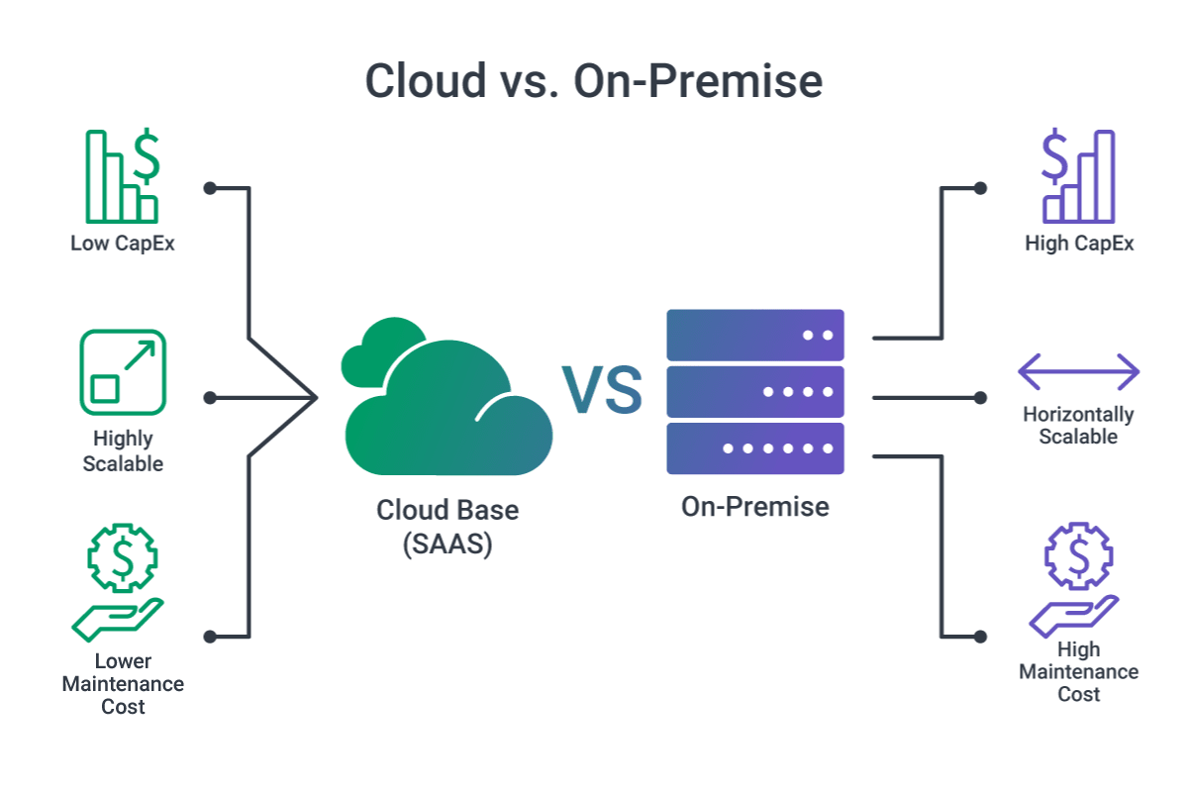
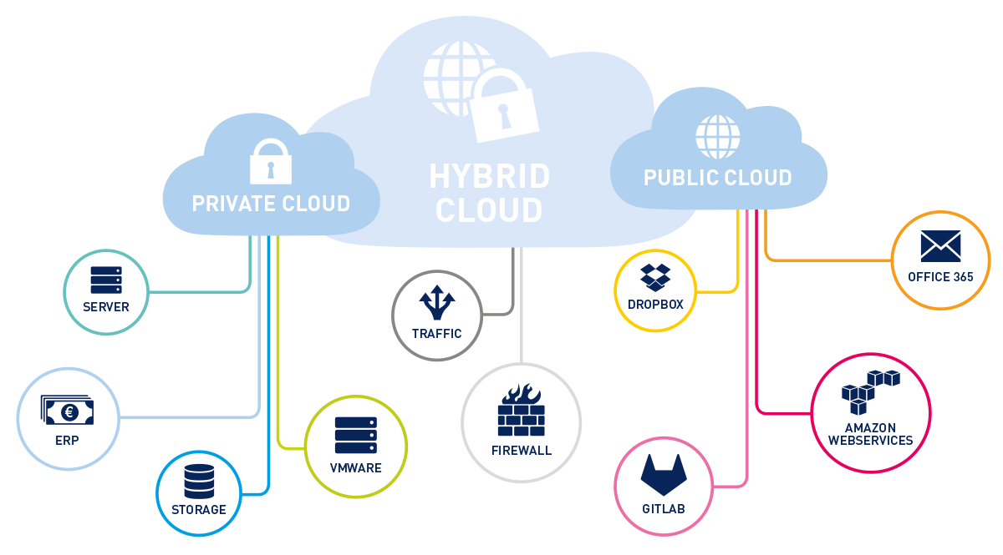
✅ On-Premises VM-Based Deployment
Deployed on the company’s own infrastructure (physical or virtual machines).
Offers complete control over data security but requires maintenance.
3. Hybrid Deployment
✅ Best of both worlds: Some components in the cloud, others on-premises. ✅ Useful for companies migrating to cloud while maintaining sensitive data on-site.

Slide 31
System Testing Strategies in Watermelon
To ensure high-quality software, Watermelon follows a comprehensive testing strategy with multiple testing types.
1. Unit Testing
✅ Focuses on testing individual components. ✅ Ensures that each function or module works correctly in isolation. ✅ Example: Validating Watermelon’s self-healing algorithm at a function level.
2. Integration Testing
✅ Tests interactions between different modules. ✅ Ensures smooth data flow between Test Execution Engine, AI Optimization, and Reporting Module. ✅ Example: Checking if test execution results are correctly synced with JIRA/Azure DevOps.
3. Performance Testing
✅ Evaluates execution speed, scalability, and system stability. ✅ Includes:
Load Testing – Testing performance under normal conditions.
Stress Testing – Checking how Watermelon handles extreme loads.
Scalability Testing – Ensuring smooth operation with large test suites.

Slide 32
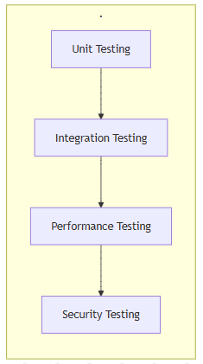
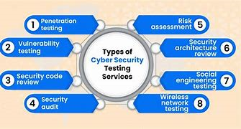
4. Security Testing
✅ Validates secure data handling and access control. ✅ Includes:
Penetration Testing – Simulating cyberattacks to identify vulnerabilities.
Authentication Testing – Ensuring only authorized users can access test cases. ✅ Example: Preventing unauthorized modifications to critical test scripts.

Slide 33
Results & Benefits of Using Watermelon
Watermelon provides AI-driven automation to improve software quality, accelerate testing, and reduce costs.
1. Faster Test Execution 🚀
✅ 70% reduction in execution time using AI-optimized test selection. ✅ Supports parallel execution across multiple platforms.
2. Improved Test Coverage 📈
✅ Covers web, mobile, and API testing in one platform. ✅ AI-driven self-healing scripts ensure adaptability to UI changes.
3. Reduced Maintenance Effort ⚡
✅ Self-healing test automation dynamically adjusts scripts. ✅ Reduces test script maintenance costs by 50%.
4. Intelligent Defect Detection 🔍
✅ Predictive analytics detect high-risk test cases early. ✅ AI-based defect tracking reduces bug-fixing time.

Slide 34
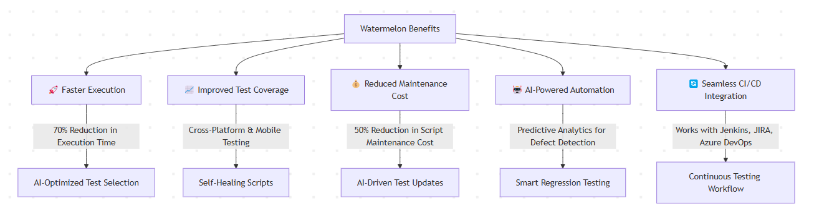
5. Seamless CI/CD Integration 🔄
✅ Works with Jenkins, JIRA, Azure DevOps for continuous testing. ✅ Ensures faster time-to-market with high-quality releases.

Slide 35
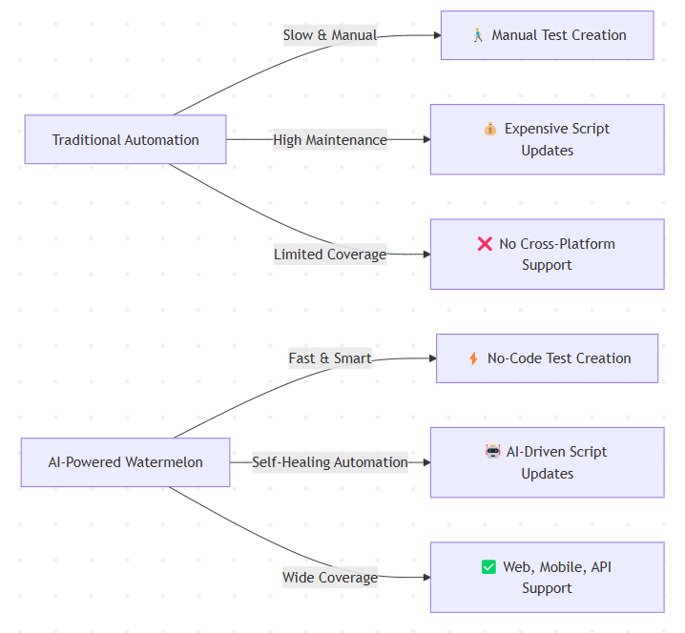

Slide 36
The Future of Watermelon – Advancing AI in Testing
Watermelon is continuously evolving to enhance AI-driven automation, expand integrations, and improve efficiency.
1. AI-Powered Test Case Generation 🤖
✅ AI will automatically generate test cases based on historical data. ✅ Reduces manual effort in creating test cases.
2. Enhanced Predictive Analytics 📊
✅ AI will analyze past test executions to predict potential defects. ✅ Proactively suggests test optimizations before execution.
3. Deeper Integration with Cloud & DevOps ☁️
✅ Better integration with AWS, Google Cloud, Azure Pipelines. ✅ Supports serverless testing for scalable automation.
4. Automated Test Maintenance & Optimization 🔧
✅ AI will auto-update test scripts for UI & functional changes. ✅ Smart regression testing will prioritize tests based on impact analysis.

Slide 37
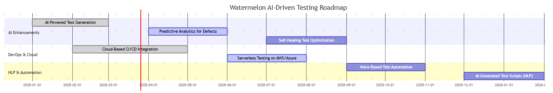
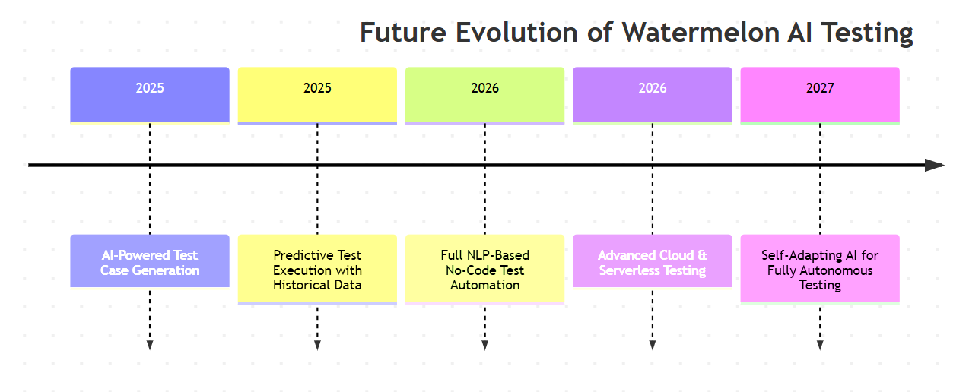
5. AI-Driven Voice & NLP-Based Testing 🎙️
✅ Future support for voice-based test automation using NLP. ✅ Users can describe test cases in natural language, and AI will generate scripts.

Slide 38
Conclusion – Watermelon’s Impact on Test Automation
Watermelon revolutionizes software testing by combining AI-driven automation, no-code test creation, and predictive analytics. It enhances efficiency, reliability, and scalability, enabling organizations to deliver high-quality software faster.
Key Takeaways:
✅ AI-Powered Testing – Self-healing automation reduces maintenance effort. ✅ Faster Execution – Optimized test selection cuts execution time by 70%. ✅ Seamless CI/CD Integration – Ensures continuous testing & deployment. ✅ Scalable & Cross-Platform – Supports web, mobile, and desktop applications. ✅ Improved Test Coverage – Data-driven insights enhance software quality.
Final Thought:
Watermelon’s AI-driven approach transforms software testing from a reactive process to a proactive, intelligent system, ensuring faster releases, reduced costs, and higher reliability.

Slide 39
Thank You
Content Suggestions:
"We appreciate your time! Do you have any questions?"
"Contact us for more details: 📧 Email: vishal1543.be21@chitkara.edu.in 📱 Roll No: 2110991543 Group: 15-B
🏠 Mobile : 8427861597
39

